Slide 1
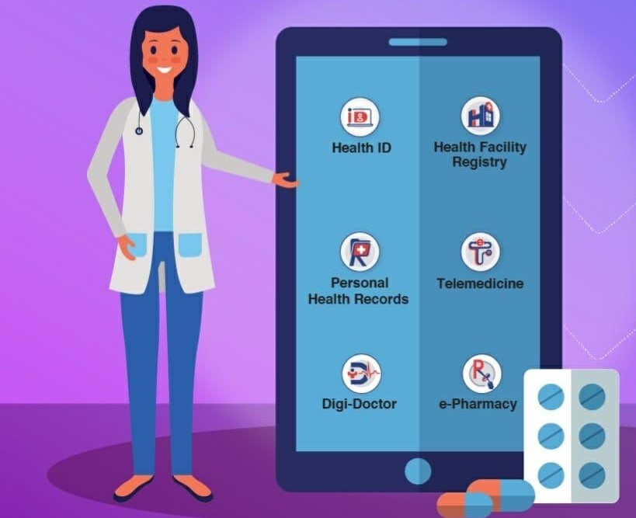
PM Digital Health Mission
Ijlal Ahmad
Muhammad Hassaan
Jamia Millia Islamia, New Delhi

Slide 2
Health ID Card
A Health ID Card will act as a Health Account of every Indian.
This will contain all the details related to the tests, diseases, doctors visited,
medicines, Reports and diagnosis.
Every information related to the health of an individual will be included in
the Health ID Card.
The Health ID Card is created with the help of the details such as Aadhar and
Mobile Number of an individual, generating a unique ID for every individual.
Also, the Health ID Card is voluntary and a person will be given the treatment
if he doesn’t want a Health ID Card.

Slide 3
Personal Health Records (PHR)
The health records which will be in control of the individual will be in this
system.
This is specifically for the individuals themselves to enable them to manage
the information about their health.
Digi Doctor
All the details of the doctors enrolled in the country including their name,
qualifications, name of the institutions of qualifications, specializations,
registration number with state medical councils, years of experience, etc.

Slide 4
Health Facility Registry (HFR)
All the health facilities such as hospitals would be registered into the
system with all details such as services offered, specialties, etc.
Tele-medicines and e-pharmacies
The (PM-DHM) will also allow patients to access health services remotely
through tele-consultation and e-pharmacies, as well as offer other health
related benefits.

Slide 5
How it will enhance India’s health Infrastructure
It made India's health infrastructure technology enabled and integrated at
some extent.
This will minimizes the maintenance of health related documents like test
reports, prescribed medicines etc.
Analysis of health data will lead to better planning, budgeting an
implementation for states and health programs, which should be a big
cost optimizer.

